Slide 1
CSIT988/CSIT488 Security, Ethics and Professionalism Week 13: Revision
Subject Coordinator: Guangyou Zhou
Central China Normal University
Spring 2024

Slide 2
Technical Fail
To be eligible for a Pass in this subject a student must achieve a mark of at least 40% (20 out of 50) in the Final Exam. Students who fail to achieve this minimum mark & would have otherwise passed may be given a TF (Technical Fail) for this subject.

Slide 3
Supplementary Exams
The School does not normally offer a supplementary exam to a student who has sat a scheduled exam.
Supplementary Exams will be dealt with in accordance with student academic consideration policy (http://www.uow.edu.au/about/policy/UOW060110.html) 9.2 Timing of Supplementary Exams.
While the School normally grants supplementary exams when the student does not sit the standard exam for an acceptable reason, each case will be assessed on its own merit and there is no guarantee a supplementary exam will be granted.
If a supplementary exam is granted, you will normally be notified via SOLS Mail the time and date of this supplementary exam. You must follow the instructions given in the email message.
Please note that if this is your last session and you are granted a supplementary exam, be aware that your results will not be processed in time to meet the graduation deadline.

Slide 4
Final Exam
1 June 2023, from 16:00 to 19:00 (3 Hours)
Double check the exam timetable to ensure you are in the right exam at the right time.
Close Book

Slide 5
Final Exam
Total marks: 50
Part A (10 marks)
5 multiple choice questions
Each question only has ONE correct answer
Get 2 marks for a correct answer

Slide 6
Final Exam
Part B (30 marks)
15 short answer questions

Slide 7
Final Exam
Part C (10 marks)
A case study
Two questions (5 mark each)

Slide 8
Week | Lecture Topics | Readings
1 | Introduction and overview of the subject | Chapter 1 / No Tutorials
2 | Information security management | Chapter 1
3 | Planning for security | Chapter 2
4 | Planning for contingencies | Chapter 3
5 | Information security policy | Chapter 4
7 | Developing the security program | Chapter 5
8 | Security management models & practices | Chapter 6, 7
9 | Risk management: identifying and accessing risk | Chapter 8
10 | Risk management: controlling risk | Chapter 9
11 | Protection mechanisms | Chapter 10
12 | Personnel and security, Law and Ethics | Chapter 11, 12
13 | Revision

Slide 9
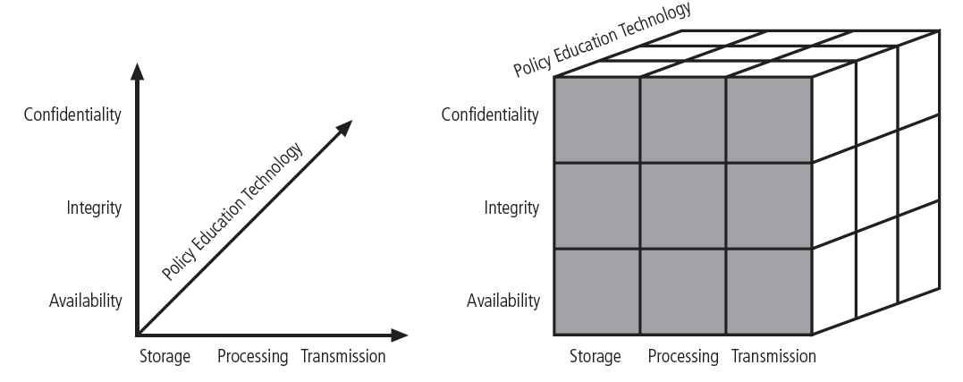
CNSS Security Model
Figure 1-2 CNSS security Model
Notes:
9
Committee on National Security Systems (CNSS) Security Model
Also known as the McCumber Cube
Provides a more detailed perspective on security
Covers the three dimensions of information security
When using this model to design or review any information security program, you must make sure that each of the 27 cells is properly addressed by each of three communities of interest.

Slide 10
Key outcomes
What is security?
What is information security?
Key concepts explained, e.g., C.I.A, privacy, identification, authentication, authorisation, accountability, policy, etc.

Slide 11
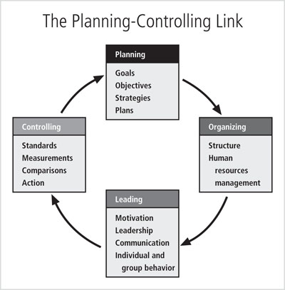
Management Characteristics
Figure 1-3 The planning-controlling link
Notes:
Two basic approaches to management
Traditional management theory
Uses the core principles of planning, organizing, staffing, directing, and controlling (POSDC)
Popular management theory
Categorizes the principles of management into planning, organizing, leading, and controlling (POLC)

Slide 12
Principles of Information Security Management
The extended characteristics of information security are known as the six P’s
Planning
Policy
Programs
Protection
People
Project Management

Slide 13
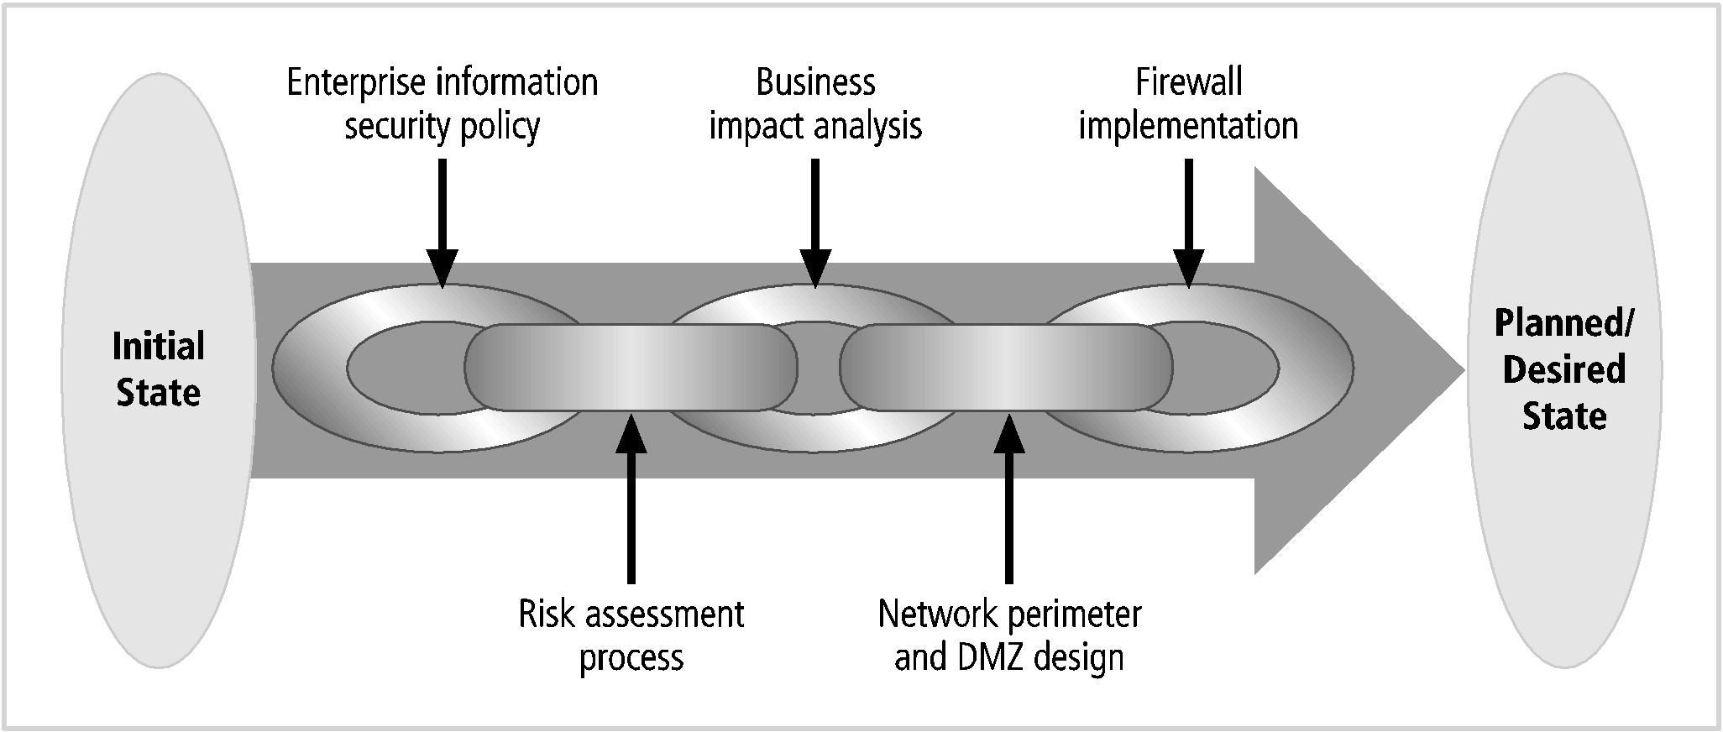
Project Management (cont’d.)
Source: Course Technology/Cengage Learning
Notes:
Project Management
The application of knowledge, skills, tools, and techniques to project activities to meet project requirements
Accomplished through the use of processes
Such as initiating, planning, executing, controlling, and closing
Involves the temporary assemblage resources to complete a project
Some projects are iterative, occurring regularly (e.g., budgets)

Slide 14
Key outcomes
What is management?
What is POLC and how does it work?
What are the unique functions of InfoSec management known as “the six Ps”?
Why and how the project management is applied to security?
Notes:
First identify an established project management methodology
PMBoK (Project Management Body of Knowledge) is considered the industry best practice
Other project management practices exist

Slide 15
Fundamentals of Contingency Planning
Incident response planning (IRP)
Focuses on immediate response
Disaster recovery planning (DRP)
Focuses on restoring operations at the primary site after disasters occur
Business continuity planning (BCP)
Facilitates establishment of operations at an alternate site

Slide 16
Key outcomes
What is contingency planning and why is it important?
What are the three types of contingency plan and what are their respective usage context?

Slide 17
Policy
Types of information security policy
Enterprise information security program policy
Issue-specific information security policies
Systems-specific policies
Notes:
EISP:
Sets strategic direction, scope, and tone for organization’s security efforts
Assigns responsibilities for various areas of information security
Guides development, implementation, and management requirements of information security program
ISISP:
Provides detailed, targeted guidance
Instructs the organization in secure use of a resource, such as technology systems
Begins with introduction to fundamental resource-use philosophy of the organization
Protects both the employee and organization from inefficiency and ambiguity
SysSP:
System-specific security policies (SysSPs) frequently do not look like other types of policy
They may function as standards or procedures to be used when configuring or maintaining systems
SysSPs can be separated into
Management guidance
Technical specifications
Or combined in a single policy document

Slide 18
Key outcomes
What roles do policies play in information security management?
What are the three types of policy? What are they about (what do they address)? Who will define these policies.
How to make policies effective? (develop, distribute, review, understand, agree, enforce)

Slide 19
Organizing for Security
Variables involved in structuring an information security program
Organizational culture
Size
Security personnel budget
Security capital budget
As organizations increase in size:
Their security departments are not keeping up with increasingly complex organizational infrastructures

Slide 20
Implementing Security Education, Training, and Awareness Programs
SETA program
Designed to reduce accidental security breaches
Consists of three elements: security education, security training, and security awareness
Awareness, training, and education programs offer two major benefits:
Improving employee behavior
Enabling the organization to hold employees accountable for their actions

Slide 21
Key outcomes
What are the typical reporting structures in organisations of various sizes (very large, large, medium, small) and their advantages and limitations?
What are the purposes of security education, training, and awareness programs?
How to make a SETA program effective?

Slide 22
Access Control Models
Key principles of access control
Least privilege
The principle by which members of the organization can access the minimum amount of information for the minimum amount of time necessary to perform their required duties
Need to Know
Limits a user’s access to the specific information required to perform the currently assigned task, and not merely to the category of data required for a general work function
Separation of Duties
A control requiring that significant tasks be split up in such a way that more than one individual is responsible for their completion

Slide 23
Key outcomes
What is access control?
What are the key principles of access control?
What are the categories of access control?
What are the available access control techniques?
Something you know
Something you have
Something you are
Something you produce

Slide 24
Benchmarking
Benchmarking
Following the existing practices of a similar organization, or industry-developed standards
Can help to determine which controls should be considered
Cannot determine how those controls should be implemented in your organization

Slide 25
Key outcomes
What is benchmarking and why do organisations do benchmarking?
What are the categories of benchmarking? (due care/due diligence, recommended practices)
What are the benefits and limitations of benchmarking?
What is baselining and why do organisations do baseling?
What is performance measurement and why do organisations do performance measurement?

Slide 26
Risk management
Information security departments are created primarily to manage IT risk
Managing risk is one of the key responsibilities of every manager within the organization
In any well-developed risk management program, two formal processes are at work
Risk identification and assessment
Risk control

Slide 27
Key outcomes
What is risk management?
How do organisations identify and assess risks?
Terms explained, e.g., information assets, threats, vulnerabilities, etc.
What are the results of risk assessment?
What are the risk control strategies?
Why do organisations do feasibility studies and what feasibility studies do they do?

Slide 28
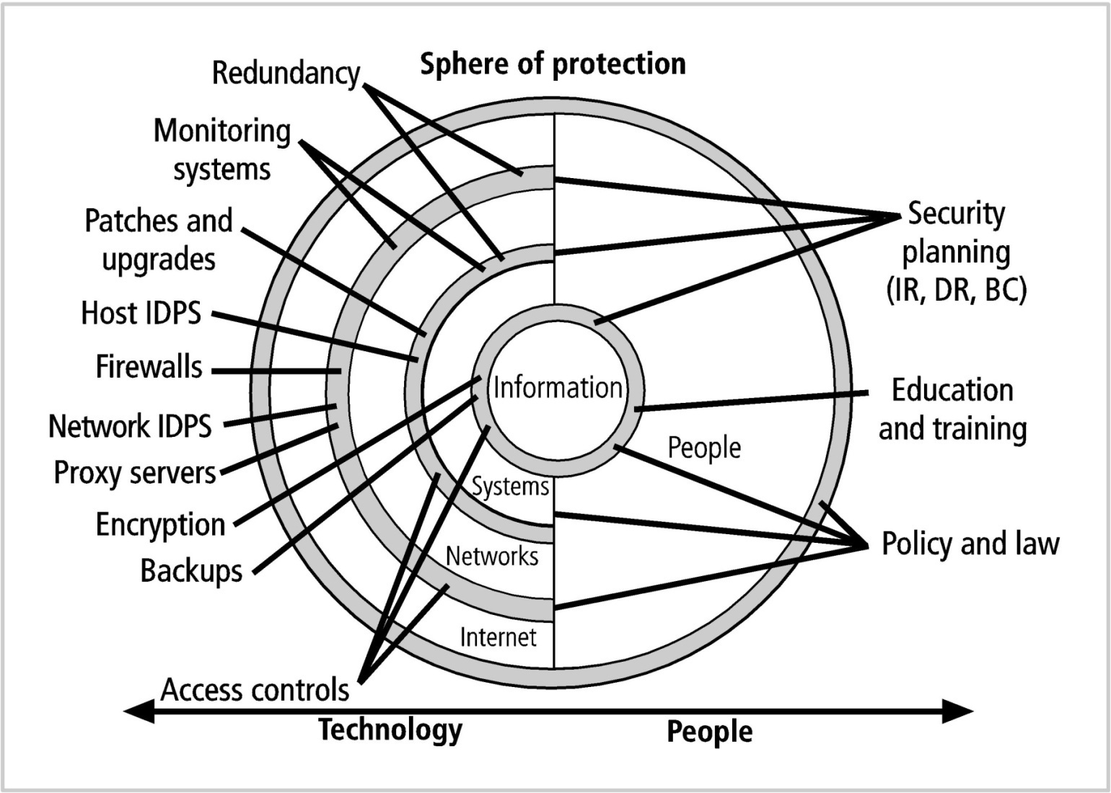
Protection mechanisms

Slide 29
Key outcomes
Typical protection mechanisms explained
Access control
Firewall
IDPS
Cryptography

Slide 30
Employment Policies and Practices
Management should integrate solid information security concepts
Across all of the organization’s employment policies and practices
Including information security responsibilities into every employee’s job description and subsequent performance reviews
Can make an entire organization take information security more seriously

Slide 31
Key outcomes
Describe the security considerations in the process of employment.
Hiring
Firing

Slide 32
Final notes
Information security management is about management, not technology
It is the responsibility of the information security community, the information technology community, and the general business community to protect the organisation’s information assets
Information security management is to support the strategic goal of the organisation

Slide 33
My final advices for the exam
Have a look at the lecture notes
Have a look at the workshop questions
Good luck

